Slide 1
700/800 MHz Interference protection methods
NRPC APCO 2017 Conference
David buchanan

Slide 2
Protection Methods
What is the end goal? Is it maximum frequency reuse while protecting all co and adjacent channel systems? If it is maximum reuse then Interference limited Protection methods need to be used.
Noise Limited Protection
Interference limited Protection
Which method is best? Shouldn’t systems be protected down to the noise floor?

Slide 3
Noise Limited System
In today’s environment is this the best approach?
Any signal above the Noise floor may interfere with the system.
Un-Faded Signal Level
Approximately 5 -8 dB
Reference Level
Noise Floor
Signal

Slide 4
Interference Limited System
VCPC Margin
As long as the ratio S/(N+I) is => VCPC margin, there will be no interference
Un-Faded Signal Level
Approximately 5 -8 dB
Reference Level
Some regions require an Interference limited system design
Noise Floor
Signal

Slide 5
Signal Levels
700-800 MHz example:
Higher value for Interference limited systems or Portable coverage
-94 dBm (40 dBu)
-106 dBm (28 dBu)
Faded Threshold
-116 dBm (18 dBu)
Static Threshold
-123 dBm (11 dBu)
Inferred Noise Floor
Notes:
Faded Threshold is value for Desired DAQ in the presence of Multipath fading. Noise limited system for portables maybe assume -10 db antenna gain Inferred Noise Floor includes the Noise Figure of the Receiver

Slide 6
Definitions
VCPC or CPC – Channel Performance Criterion: The maximum BER at a specified vehicular Doppler rate necessary to deliver a specific DAQ for the specific modulation.
DAQ – Delivered Audio Quality: Similar to Circuit Merit but includes definitions for Digital Audio
ENBW – Equivalent Noise Bandwidth: The frequency span of an ideal filter whose area equals the area under the actual power transfer function curve and whose gain equals the peak gain of the actual power transfer function.
ACP – Adjacent Channel Power: The energy from an adjacent channel transmitter that is intercepted by prescribed bandwidth, relative to the power of the emitter. ACP = 1/ACPR
ACPR – Adjacent Channel Power Ratio: The ratio of the total power of a transmitter under prescribed conditions and modulation, within its maximum authorized bandwidth to that part of the output power which falls within a prescribed bandwidth centered on the nominal offset frequency of the adjacent channel ACPR = 1/ACP

Slide 7
Difference - Interference vs. Coverage
For interference model use median values 50% for confidence values
For coverage use higher – typically 97% for tile models
For interference modeling the land use tables must be used or not used on a consistent basis. Never use them for one study and then not use for another.
For coverage use land use attenuation tables
For coverage consider calling out important buildings or area that must have coverage.
Consider talk out and talk in coverage or interference

Slide 8
Contours (R6602) for Interference protection
Contours do not show real world values of signal strength
They are based on terrain out to 10 miles and assume that the HAAT stays the same for all greater distances
Most 800 MHz regions started out using contours for interference protection.
Almost all used 5,25,40 dBu for the values
This was based on noise limited interference protection.
While the coverage contour required was 40 dBu for all stations , the protection was based on units operating to the static threshold of -116 dBm or 18 dBu
The 25 dBu values for offset stations was based on an additional 20 dB of protection between two analog stations using 4 kHz transmit deviation

Slide 10
These Contours are not the real signal levels

Slide 11
The Longley/Rice Matrix Study is much better

Slide 12
So this shows that the Moreno Vly station will work co-channel with the OC station but depending on service area for the SBC station there may be problems being offset to the hypothetical SBC station
This shows what can work when interference protection is based on Interference Limited modeling.

Slide 13
RPC8 NPSPAC EXAMPLE
WTC - FREEDOM TOWER

Slide 14
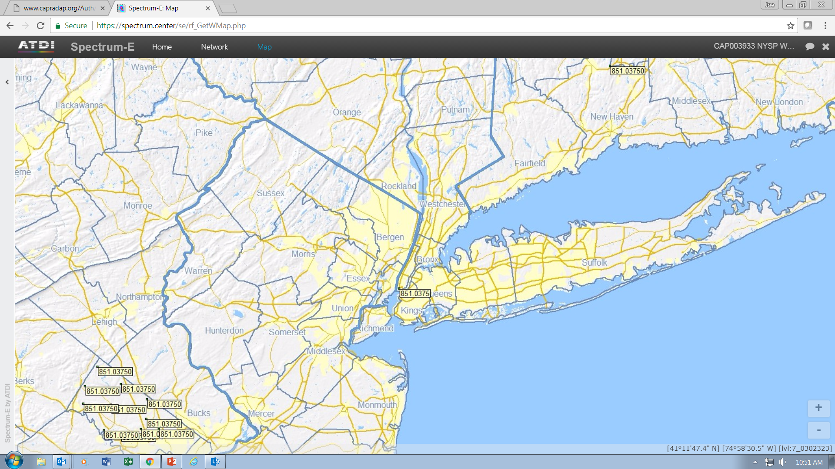
Co-channel incumbents
Proposed site

Slide 15
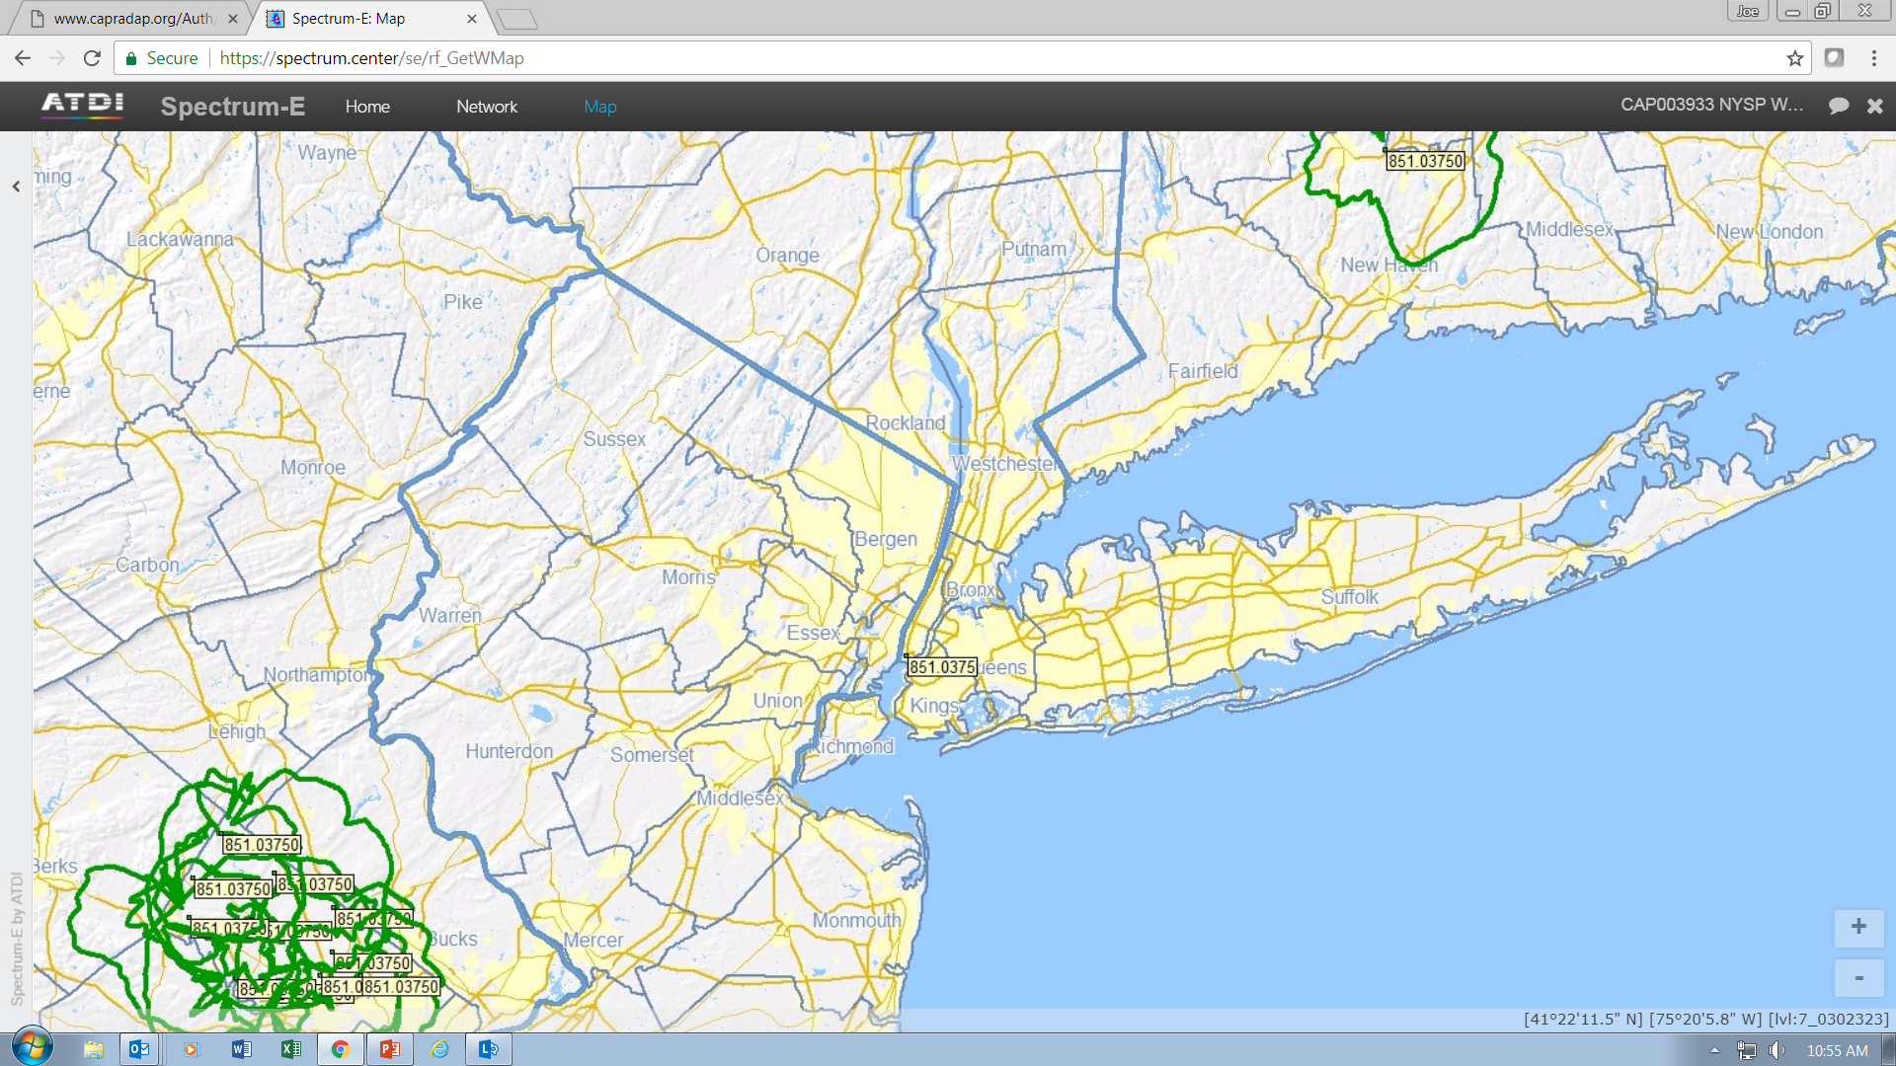
40 dBu OHD Suburban

Slide 16
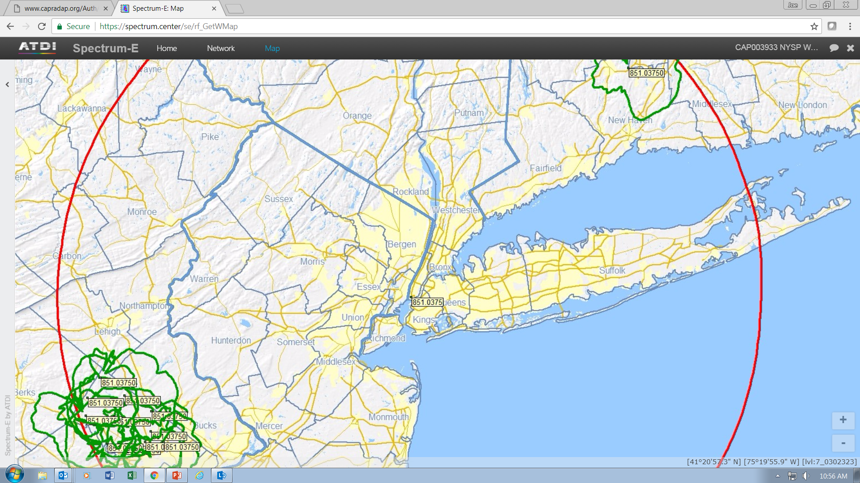

5 dBu OHD Suburban

Slide 17
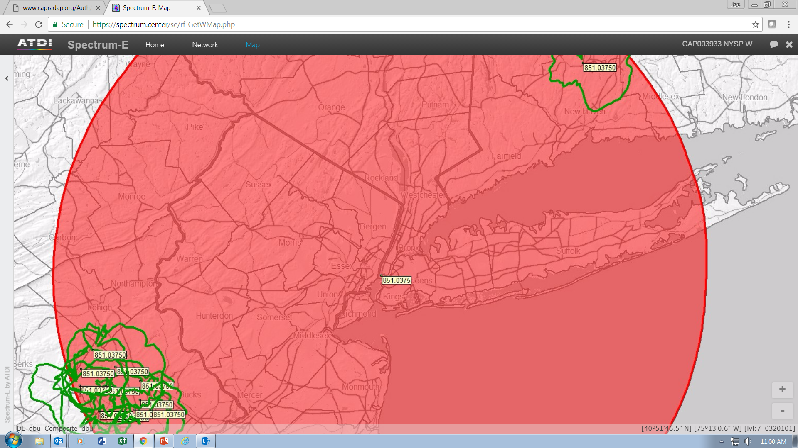

Slide 18
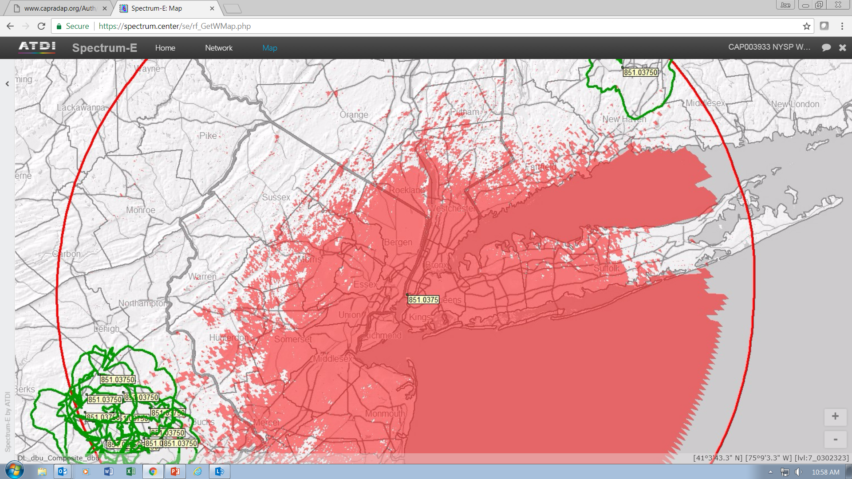
LONGLEY-RICE MODEL
50/50/50 WITH TERRAIN
5dbu

Slide 19
Interference Limited modeling
Must specify a minimum signal level for the defined service area for each station i.e. 40 dBu or greater in the jurisdictional boundaries plus a 3 mile buffer or other definition of service area
Only the defined service area is protected.
TSB-88 methods must be used with a suitable propagation model that uses matrix tile modeling.
Most suitable model for Public Safety is Longley/Rice as it is accurate and open source.
Requires more use of patterned and/or down tilted antennas. May require more stations in some cases to avoid excessive signal levels outside of the service area.
TSB-88 will model interference for co and adjacent channel interference with any type of modulation used by each system

Slide 20
TSB-88 Methods
The TSB-88 Technical Services Bulletin defines methods to be used to model interference between stations and radio systems
It includes the effects of modulation, receive filters, propagation and frequency to determine interference between stations
It covers most all radio technologies that are in current use
It is VERY important to use the correct emissions designators when doing the studies as that tells the computer software what TSB-88 table to use in the modeling

Slide 21
Co-channel interference
For interference limited protection, TSB-88 provides Annex A Table A-1 that can be used for interference analysis

Slide 22
ACPR Illistration Chart
TX

Slide 23
Adjacent Channel Interference
When the channel spacing is less than the occupied bandwidth of a channel, adjacent channel interference must be considered
This applies to 800 MHz NPSPAC Band and can apply to the 700 MHz band
For 800 MHz NPSPAC, 20kHz occupied band width permitted (for analog modulation TX deviation is limited to +/- 4 kHz) Digital modulation uses a different emissions mask
When channel spacing is > than the occupied band width (such as P25 to P25), the TX spurious noise power is down 70 dB or greater with the common LMR modulation technologies
That is enough to prevent adjacent channel interference on those bands provided the service areas of the two systems do NOT overlap

Slide 24
Adjacent Channel Interference
Let’s consider a NPSPAC 800 MHz case
City of Los Angeles wants to operate offset to San Diego Transit
City of LA will use P25 modulation and the Transit is using analog FM 4 kHz modulation
The channels are spaced 12.5 kHz apart and there is some overlap of the occupied bandwidth
The ENBW for a P25 receiver is 5.5 kHz and for analog 4 kHz Deviation the ENBW is 12.6 kHz (from Table 5 IF Filter Specifications)
To analyze the case of San Diego sites interfering with City sites, the computer program looks up the ACPR in Table A.6.2.4 (Analog FM 4 kHz Modulation) under the 12.5 kHz Offset table for ENBW 5.5 and RRC filter which = 57.09 dB
This value will either reduce the interfering TX ERP by the ACPR value or reduce the tile signal level for the interfering TX
The adjusted interfering signal level for each tile is compared to the desired (City) signal level for each tile

Slide 25
ENBW Table in TSB-88

Slide 26
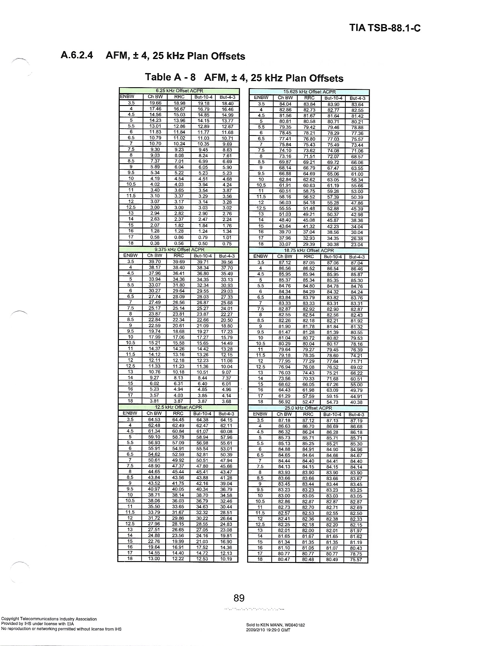
OFF SEt Table for additional adjacent channel protection 4 Khz Analog
Adjacent channel protection 4 kHz analog to P25

Slide 27
OFF SEt Table for additional adjacent channel protection P25
Notice the P25 to P25 12.5 kHz protection
Additional adjacent channel protection P25 to 4 kHz analog

Slide 28
Adjacent Channel Interference
If the desired signal is > the adjusted interfering signal by VCPC value in Table A-1 for the desired modulation type and DAQ value (3.4 in this case) the tile is good
In this case the VCPC value is 17.7 dB (P25) and 22 dB (Analog)
Important point – each modulation case is unique
Important point – if as in this example the modulation is not the same the analysis must be done in both directions

Slide 29
More on use of ENBW and the ACPR tables
always use the victim's ENBW and the interfering Transmitter's ACPR table to determine adjacent channel protection value
The VCPC value used comes from Table A-1 of the TSB-88 and is for the appropriate Modulation type and DAQ value

Slide 30
Proposed interference analysis (800)
If all systems use either analog 4 kHz deviation technology or a digital modulation technology, require a L/R propagation study that shows the 40 dBu signal level area and the 20 dBu signal area of the proposed station
If the 20 dBu signal is outside of the existing systems operating areas then all good co-channel

Slide 31
Proposed interference analysis
For adjacent channel this is can be done three ways
If only P25 to P25 modulation is used by the proposed and the existing stations then a simple showing that the service areas do not overlap is all that is needed
If only P25 and 4 kHz analog modulations are used by the proposed and existing stations then the following method can be used

Slide 32
Proposed interference analysis
A signal level map showing 40 and 20 dBu levels can still be used but with a modification for the above adjacent channel cases
Modify the proposed TX ERP as follows
For P25 proposed and analog existing reduce by 32 dB
For an Analog proposed and P25 existing reduce by 57 dB
For an Analog proposed and Analog existing reduce by 24 dB
For all other cases do a SARD TSB-88 study
Also the SARD can be used for any combination co or adjacent channel

